Slide 1


Spotify
Andrew Nguyen
Anne Cuzeau
Samuel Flusche
Notes:
Andrew

Slide 2

k
Welcome
Welcome
Let’s explore
Year / Popularity
Play
Follow
Not always a trend
Our Baseline Model
About the data:
No missing value, number of rows: 170,653
Includes songs from 1921 - 2021
Most columns are descriptive variables about the songs
Discarded columns: Artist name, release date (inconsistent & redundant), Tempo, Speechiness, mode, key
Improving our model
Wrapping Up
Extra slides
Notes:
Andrew

Slide 3
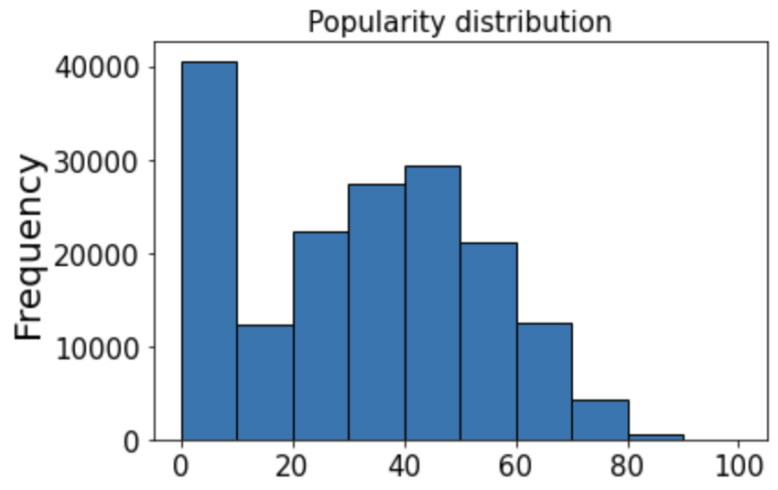
k
Data exploration
Welcome
Welcome
Let’s explore!
Let’s explore
Initial findings:
Upward trend for many factors: loudness, energy, danceability, popularity
Uneven distribution of popularity:
A lot of songs (about 16%) have a popularity of zero, and popular songs are rare
As we’ll see, we dropped some columns that did not make sense (key, mode…)
Year / Popularity
Not always a trend
Our Baseline Model
Improving our model
Wrapping Up
Extra slides
Notes:
Andrew

Slide 4

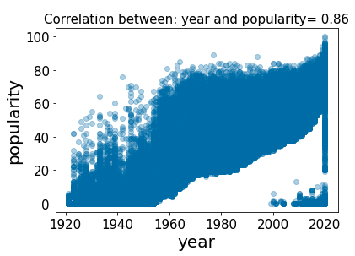
Welcome
Welcome
Year and Popularity
Let’s explore!
Let’s explore
Year / Popularity
Year and popularity
Most linear relationship: Year and Popularity (1-100)
Not always a trend
Not always a trend
Our Baseline Model
The most linear relationship: r^2 = 0.74
Most (very) popular songs are new
Can probably be explained by Spotify’s audience
Improving our model
Wrapping Up
Extra slides
Notes:
Andrew

Slide 5
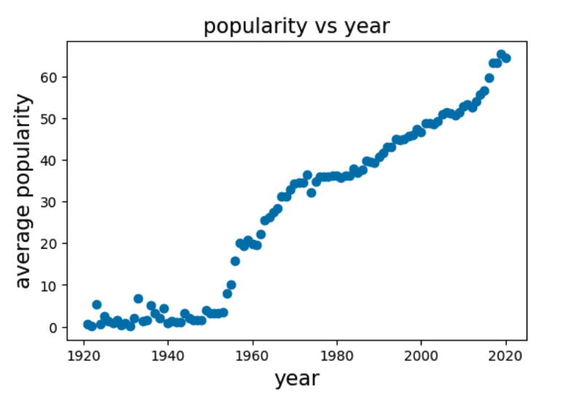
Welcome
Welcome
Year and Popularity
Let’s explore!
Let’s explore
Year and popularity
Year / Popularity
Year and Popularity: Upward trend
Not always a trend
Our Baseline Model
Average popularity per year goes up
Pitfall: how can our model predict an old but popular song accurately?
Improving our model
Wrapping Up
Extra slides
Notes:
Sam

Slide 6
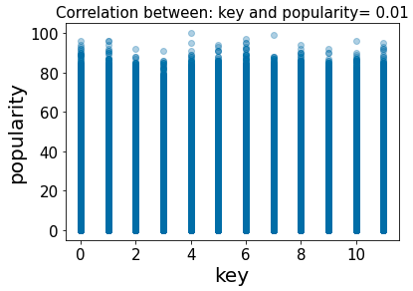
Not Always a Trend
Welcome
Welcome
Let’s explore!
Let’s explore
Multiply the Variables:
Some graphs are like this one, with no leading trend
We dropped these variables:
Tempo, Speechiness, mode, key, valence
Year / Popularity
Not always a trend
Our Baseline Model
Improving our model
Wrapping Up
Extra slides
Notes:
Sam

Slide 7
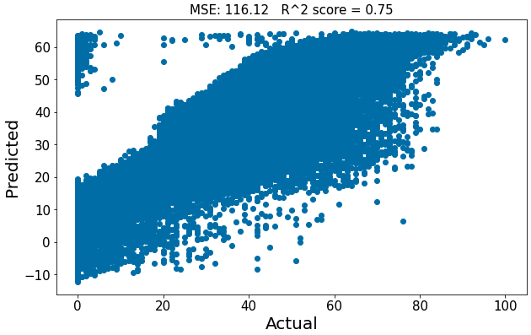
Baseline Linear Model
Welcome
Welcome
Everything, all at once:
Let’s explore!
Let’s explore
Year and popularity
Year / Popularity
Took all the variables that we did not drop and ran a linear regression
Split train/test: 70/30
Max of 60: our model is incapable of predicting any ‘popular’ song
Not always a trend
Our Baseline Model
Improving our model
Wrapping Up
Extra slides
Notes:
Sam

Slide 8
Let’s improve our model
Welcome
Welcome
Let’s explore!
Let’s explore
Balancing data
Year and popularity
Year / Popularity
Not always a trend
Goal: getting our model to predict popular song
Methodology:
Took the number of songs with popularity >= 70
Randomly selected the same amount of songs with popularity 70-30 and 30-0
Our Baseline Model
Improving our model
Wrapping Up
Extra slides
Notes:
Anne

Slide 9
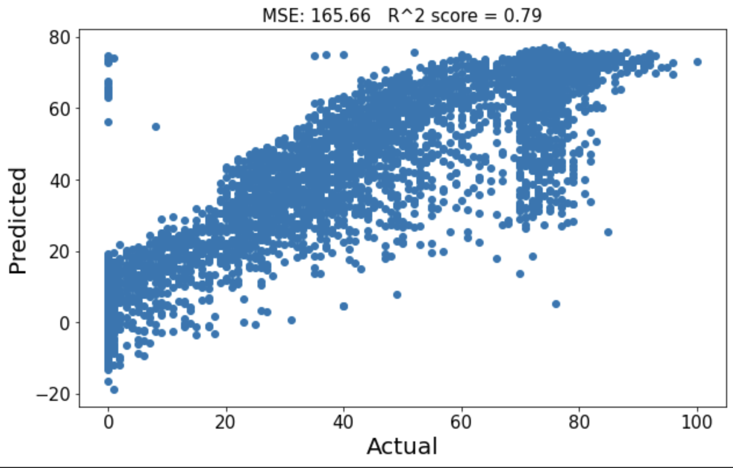
Let’s improve our model
Welcome
Welcome
Let’s explore!
Let’s explore
Balancing data
Year and popularity
Year / Popularity
Not always a trend
Results:
Better job (more linear, predicts to 80) except around 70
MSE is up because we are making ’costly’ mistakes between 70 & 80 and below 0.
Our Baseline Model
Improving our model
Wrapping Up
Extra slides
Notes:
Anne

Slide 10
Let’s improve our model
Welcome
Welcome
Let’s explore!
Acousticness: at first, looks like lower acousticness is better!
Let’s explore
Year and popularity
Year / Popularity
Not always a trend
Acousticness is actually trending down
However the relationship between popularity and acousticness changes over time:
older songs with low values are more likely to be popular
newer songs with higher values are more likely to be popular
Our Baseline Model
Improving our model
Wrapping Up
Extra slides
Notes:
Anne

Slide 11
Let’s improve our model
Welcome
Welcome
Let’s explore!
Other factors
Let’s explore
Year and popularity
Year / Popularity
Energy and loudness seemed like good candidates but after ‘de-trending’: popular and unpopular songs have the same range regardless of the year
Instrumentalness: trending down, but lower is better across years
Duration & Danceability: popular and unpopular songs have the same range regardless of the year
Look for relationships between factors: only loudness and energy were correlated (0.78)
Not always a trend
Our Baseline Model
Improving our model
Wrapping Up
Extra slides

Slide 12
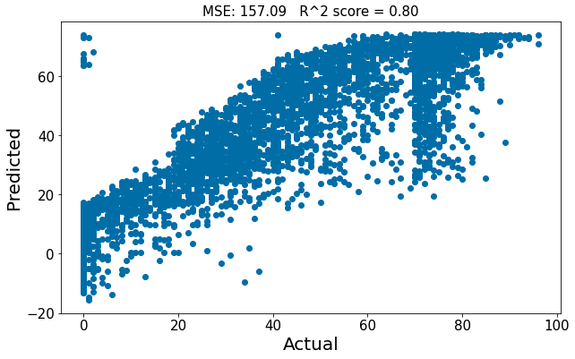
Putting it all together
Welcome
Welcome
Let’s explore!
Calculated coefficients, year and balanced data
Let’s explore
Year and popularity
Year / Popularity
Not always a trend
Results:
Still not predicting to 100
Higher r^2: slightly better fit
MSE is still up (same mistakes) between 70 & 80 and below 0.
Our Baseline Model
Improving our model
Wrapping Up
Extra slides

Slide 13
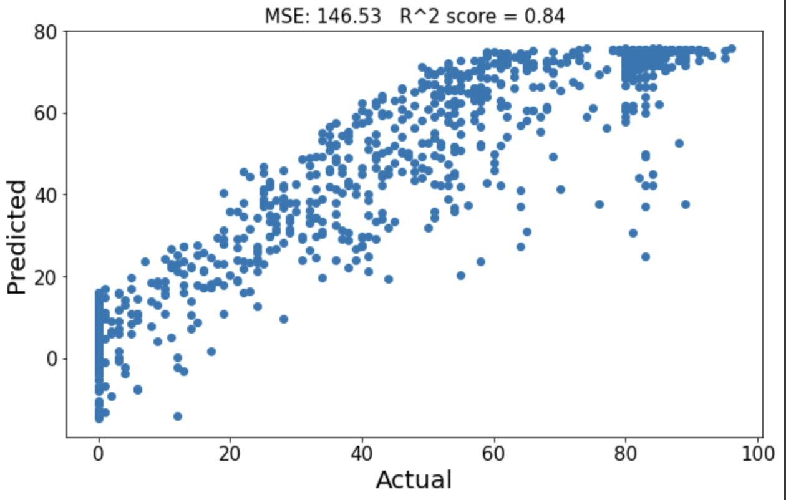
Putting it all together
Welcome
Welcome
Let’s explore!
Narrower samples: popularity >80, 79-50, 49-20, <20
Let’s explore
Year and popularity
Year / Popularity
Results:
As expected: smaller training set
Better r^2: better fit, up by 9 points
MSE is down: fewer mistakes but smaller data set
Still not predicting 100
Not always a trend
Our Baseline Model
Improving our model
Wrapping Up
Extra slides

Slide 14
Wrapping Up
Welcome
Welcome
Let’s explore!
Our best model
Let’s explore
Year and popularity
Year / Popularity
Not always a trend
Why it is our best:
Lower MSE, highest r^2 → more linear relationship
Not as many mistakes for high values
Still not predicting extreme (low and high) values accurately
Our Baseline Model
Improving our model
Wrapping Up
Extra slides
Notes:
Andrew

Slide 15
Wrapping Up
Welcome
Welcome
Let’s explore!
Our model’s most ‘costly’ mistakes
Let’s explore
Year and popularity
Year / Popularity
Methodology: Top 20 songs with the largest difference between predicted and actual popularity
→ Almost all songs were unpopular songs (0) predicted to be between 65-80
EXCEPT for “White Christmas”: 78 in popularity, 5 according to our model
Not always a trend
Our Baseline Model
Improving our model
Wrapping Up
Extra slides
Notes:
Sam

Slide 16

Thank You
0:23
-3:25

Slide 17
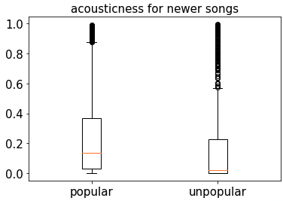
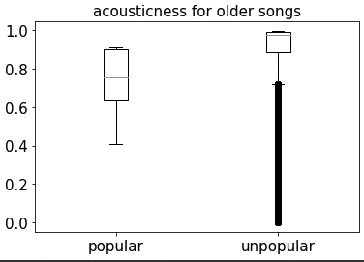
Acousticness for older & newer songs
Welcome
Welcome
Let’s explore!
Newer: 2000-2021, Older: <1960
Let’s explore
Year and popularity
Year / Popularity
Not always a trend
Our Baseline Model
Improving our model
Wrapping Up
Extra slides

Slide 18
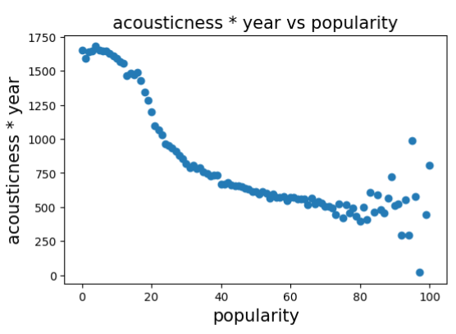
Welcome
Welcome
Further Assessing the Relationship
Let’s explore!
Let’s explore
Year and popularity
Year / Popularity
Multiply the Variables:
Not always a trend
Our Baseline Model
Multiplying columns shows relationship with no extraneous variables
Improving our model
Wrapping Up
Extra slides
Notes:
Sam

